Slide 1
KNN Algo

Slide 2
What is KNN
K-Nearest Neighbour is one of the simplest Machine Learning algorithms based on Supervised Learning technique.
K-NN algorithm assumes the similarity between the new case/data and available cases and put the new case into the category that is most similar to the available categories.
K-NN algorithm stores all the available data and classifies a new data point based on the similarity. This means when new data appears then it can be easily classified into a well suite category by using K- NN algorithm.
K-NN algorithm can be used for Regression as well as for Classification but mostly it is used for the Classification problems.

Slide 3
K-NN is a non-parametric algorithm, which means it does not make any assumption on underlying data.
It is also called a lazy learner algorithm because it does not learn from the training set immediately instead it stores the dataset and at the time of classification, it performs an action on the dataset.
KNN algorithm at the training phase just stores the dataset and when it gets new data, then it classifies that data into a category that is much similar to the new data.

Slide 4
How it Works
The K-NN working can be explained on the basis of the below algorithm:
Step-1: Select the number K of the neighbors
Step-2: Calculate the Euclidean distance of K number of neighbors
Step-3: Take the K nearest neighbors as per the calculated Euclidean distance.
Step-4: Among these k neighbors, count the number of the data points in each category.
Step-5: Assign the new data points to that category for which the number of the neighbor is maximum.
Step-6: Our model is ready.

Slide 5
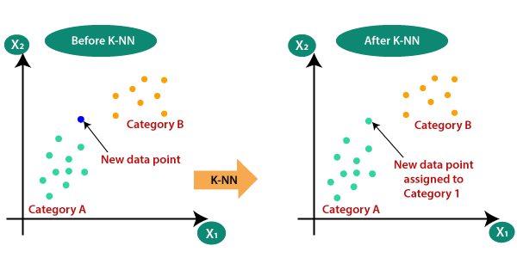

Slide 6
Advantage and disadvantage of KNN
Advantages of KNN Algorithm:
It is simple to implement.
It is robust to the noisy training data
It can be more effective if the training data is large.
Disadvantages of KNN Algorithm:
Always needs to determine the value of K which may be complex some time.
The computation cost is high because of calculating the distance between the data points for all the training samples.

Slide 7
error_rate = [] for i in range(1,50): knn = KNeighborsClassifier(n_neighbors=i) knn.fit(X_train, y_train) pred = knn.predict(X_test) error_rate.append(np.mean(pred != y_test)) plt.figure(figsize=(15,10)) plt.plot(range(1,50),error_rate, marker='o', markersize=9)

Slide 8
KNN regressor
Similar to KNN classifier , it is used to predict numeric datatype.
KNN regression is a non-parametric method that, in an intuitive manner, approximates the association between independent variables and the continuous outcome by averaging the observations in the same neighborhood .

Slide 9
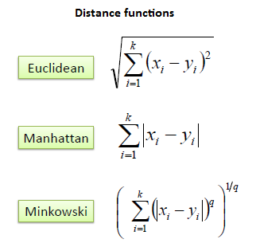
Distance used in KNN

Slide 10

Naïve Bayes Algorithm
Naïve Bayes algorithm is a supervised learning algorithm, which is based on Bayes theorem and used for solving classification problems.
It is mainly used in text classification that includes a high-dimensional training dataset.
Naïve Bayes Classifier is one of the simple and most effective Classification algorithms which helps in building the fast machine learning models that can make quick predictions.
It is a probabilistic classifier, which means it predicts on the basis of the probability of an object.
Some popular examples of Naïve Bayes Algorithm are spam filtration, Sentimental analysis, and classifying articles.

Slide 11

Why is it called Naïve Bayes?
Naïve: It is called Naïve because it assumes that the occurrence of a certain feature is independent of the occurrence of other features. Such as if the fruit is identified on the bases of color, shape, and taste, then red, spherical, and sweet fruit is recognized as an apple. Hence each feature individually contributes to identify that it is an apple without depending on each other.
Bayes: It is called Bayes because it depends on the principle of Bayes' Theorem.

Slide 12

Bayes' Theorem
Bayes' theorem is also known as Bayes' Rule or Bayes' law, which is used to determine the probability of a hypothesis with prior knowledge. It depends on the conditional probability.
The formula for Bayes' theorem is given as:
Where,
P(A|B) is Posterior probability: Probability of hypothesis A on the observed event B.
P(B|A) is Likelihood probability: Probability of the evidence given that the probability of a hypothesis is true.

Slide 13
 | Outlook | Play
0 | Rainy | Yes
1 | Sunny | Yes
2 | Overcast | Yes
3 | Overcast | Yes
4 | Sunny | No
5 | Rainy | Yes
6 | Sunny | Yes
7 | Overcast | Yes
8 | Rainy | No
9 | Sunny | No
10 | Sunny | Yes
11 | Rainy | No
12 | Overcast | Yes
13 | Overcast | Yes

Slide 14
Frequency table for the Weather Conditions:
Weather | Yes | No
Overcast | 5 | 0
Rainy | 2 | 2
Sunny | 3 | 2
Total | 10 | 5

Slide 15
Weather | No | Yes
Overcast | 0 | 5 | 5/14= 0.35
Rainy | 2 | 2 | 4/14=0.29
Sunny | 2 | 3 | 5/14=0.35
All | 4/14=0.29 | 10/14=0.71

Slide 16
P(Yes|Sunny)= P(Sunny|Yes)*P(Yes)/P(Sunny)
P(Sunny|Yes)= 3/10= 0.3
P(Sunny)= 0.35
P(Yes)=0.71
P(Yes|Sunny) = 0.6
So P(No|Sunny)= 0.5*0.29/0.35 = 0.41

Slide 17
Advantages of Naïve Bayes Classifier:
Naïve Bayes is one of the fast and easy ML algorithms to predict a class of datasets.
It can be used for Binary as well as Multi-class Classifications.
It performs well in Multi-class predictions as compared to the other Algorithms.
It is the most popular choice for text classification problems.
Disadvantages of Naïve Bayes Classifier:
Naive Bayes assumes that all features are independent or unrelated, so it cannot learn the relationship between features.

Slide 18
Types of Naïve Bayes Model
There are three types of Naive Bayes Model, which are given below:
Gaussian: The Gaussian model assumes that features follow a normal distribution. This means if predictors take continuous values instead of discrete, then the model assumes that these values are sampled from the Gaussian distribution.
Multinomial: The Multinomial Naïve Bayes classifier is used when the data is multinomial distributed. It is primarily used for document classification problems, it means a particular document belongs to which category such as Sports, Politics, education, etc. The classifier uses the frequency of words for the predictors.
Bernoulli: The Bernoulli classifier works similar to the Multinomial classifier, but the predictor variables are the independent Booleans variables. Such as if a particular word is present or not in a document. This model is also famous for document classification tasks.

Slide 19
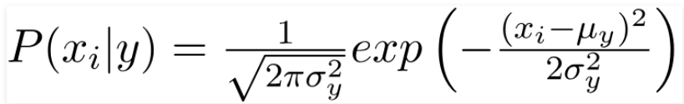
Gaussian Naïve bayes
Gaussian Naïve Bayes is used when we assume all the continuous variables associated with each feature to be distributed according to Gaussian Distribution. Gaussian Distribution is also called Normal distribution.
The conditional probability changes here since we have different values now. Also, the (PDF) probability density function of a normal distribution is given by:

Slide 20
Bernoulli vs Gaussian vs Multinomial
Bernoulli Naive bayes is good at handling boolean/binary attributes, while Multinomial Naive bayes is good at handling discrete values and Gaussian naive bayes is good at handling continuous values.
Consider a dataset which has columns like has_diabetes, has_bp, has_thyroid and then you classify the person as healthy or not. In such a scenario Bernoulli NB will work well.
Consider a dataset that has marks of various students of various subjects and you want to predict, whether the student is clever or not. Then in this case multinomial NB will work fine.
Consider a dataset that has weight of students and you are predicting height of them, then GaussiaNB will well in this case.

Slide 21
Application of Naïve Bayes
Text Classification
Most of the time, Naive Bayes finds uses in-text classification due to its assumption of independence and high performance in solving multi-class problems. It enjoys a high rate of success than other algorithms due to its speed and efficiency.
Sentiment Analysis
One of the most prominent areas of machine learning is sentiment analysis, and this algorithm is quite useful there as well. Sentiment analysis focuses on identifying whether the customers think positively or negatively about a certain topic (product or service).

Slide 22
Decision Tree
Decision Tree is a Supervised learning technique that can be used for both classification and Regression problems, but mostly it is preferred for solving Classification problems. It is a tree-structured classifier, where internal nodes represent the features of a dataset, branches represent the decision rules and each leaf node represents the outcome.

Slide 23


Slide 24
Why use Decision Trees?
There are various algorithms in Machine learning, so choosing the best algorithm for the given dataset and problem is the main point to remember while creating a machine learning model. Below are the two reasons for using the Decision tree:
Decision Trees usually mimic human thinking ability while making a decision, so it is easy to understand.
The logic behind the decision tree can be easily understood because it shows a tree-like structure.

Slide 25
Decision Tree Terminologies
Root Node: Root node is from where the decision tree starts. It represents the entire dataset, which further gets divided into two or more homogeneous sets.
Leaf Node: Leaf nodes are the final output node, and the tree cannot be segregated further after getting a leaf node.
Splitting: Splitting is the process of dividing the decision node/root node into sub-nodes according to the given conditions.
Branch/Sub Tree: A tree formed by splitting the tree.
Pruning: Pruning is the process of removing the unwanted branches from the tree.
Parent/Child node: The root node of the tree is called the parent node, and other nodes are called the child nodes.

Slide 26
Step-1: Begin the tree with the root node, says S, which contains the complete dataset.
Step-2: Find the best attribute in the dataset using Attribute Selection Measure (ASM).
Step-3: Divide the S into subsets that contains possible values for the best attributes.
Step-4: Generate the decision tree node, which contains the best attribute.
Step-5: Recursively make new decision trees using the subsets of the dataset created in step -3. Continue this process until a stage is reached where you cannot further classify the nodes and called the final node as a leaf node.

Slide 27
While implementing a Decision tree, the main issue arises that how to select the best attribute for the root node and for sub-nodes. So, to solve such problems there is a technique which is called as Attribute selection measure or ASM.
By this measurement, we can easily select the best attribute for the nodes of the tree. There are two popular techniques for ASM, which are:
Information Gain
Gini Index

Slide 28
Information Gain
Information gain is the measurement of changes in entropy after the segmentation of a dataset based on an attribute.
It calculates how much information a feature provides us about a class.
According to the value of information gain, we split the node and build the decision tree.
A decision tree algorithm always tries to maximize the value of information gain, and a node/attribute having the highest information gain is split first. It can be calculated using the below formula:
Information Gain= Entropy(S)- [(Weighted Avg) *Entropy(each feature)]

Slide 29
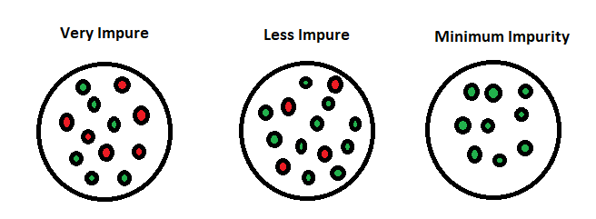
Entropy
Entropy is an information theory metric that measures the impurity or uncertainty in a group of observations. It determines how a decision tree chooses to split data. The image below gives a better description of the purity of a set.

Slide 30
Entropy: Entropy is a metric to measure the impurity in a given attribute. It specifies randomness in data. Entropy can be calculated as:
Entropy(s)= -P(yes)log2 P(yes)- P(no) log2 P(no)
Where,
S= Total number of samples
P(yes)= probability of yes
P(no)= probability of no

Slide 31
Gini Index
Gini index is a measure of impurity or purity used while creating a decision tree in the CART(Classification and Regression Tree) algorithm.
An attribute with the low Gini index should be preferred as compared to the high Gini index.
It only creates binary splits, and the CART algorithm uses the Gini index to create binary splits.
Gini index can be calculated using the below formula:
Gini Index= 1- ∑_{j}P_{j}²

Slide 32
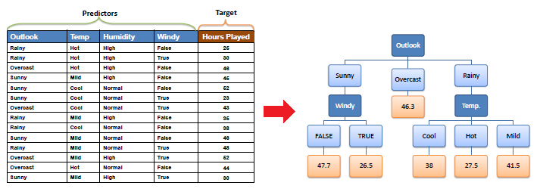
Decision Tree Regressor
https://medium.com/analytics-vidhya/regression-trees-decision-tree-for-regression-machine-learning-e4d7525d8047

Slide 33
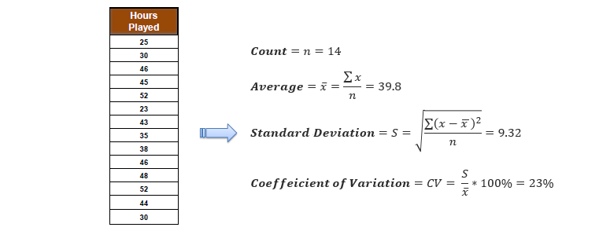

Slide 34
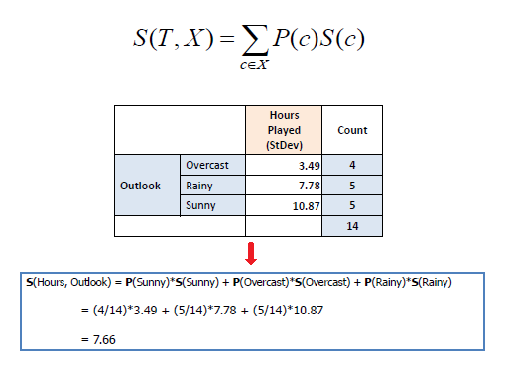

Slide 35
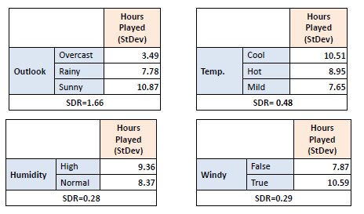
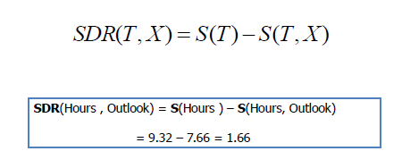

Slide 36
Pruning
Pruning is a process of deleting the unnecessary nodes from a tree in order to get the optimal decision tree.
A too-large tree increases the risk of overfitting, and a small tree may not capture all the important features of the dataset. Therefore, a technique that decreases the size of the learning tree without reducing accuracy is known as Pruning. There are mainly two types of tree pruning technology used:
Cost Complexity Pruning
Reduced Error Pruning.

Slide 37
Pruning is a technique that removes the parts of the Decision Tree which prevent it from growing to its full depth. The parts that it removes from the tree are the parts that do not provide the power to classify instances. A Decision tree that is trained to its full depth will highly likely lead to overfitting the training data - therefore Pruning is important.
In simpler terms, the aim of Decision Tree Pruning is to construct an algorithm that will perform worse on training data but will generalize better on test data. Tuning the hyperparameters of your Decision Tree model can do your model a lot of justice and save you a lot of time and money.

Slide 38
Pre-Pruning
The pre-pruning technique of Decision Trees is tuning the hyperparameters prior to the training pipeline. It involves the heuristic known as ‘early stopping’ which stops the growth of the decision tree - preventing it from reaching its full depth.
It stops the tree-building process to avoid producing leaves with small samples. During each stage of the splitting of the tree, the cross-validation error will be monitored. If the value of the error does not decrease anymore - then we stop the growth of the decision tree.
The hyperparameters that can be tuned for early stopping and preventing overfitting are:
max_depth, min_samples_leaf, and min_samples_split
These same parameters can also be used to tune to get a robust model. However, you should be cautious as early stopping can also lead to underfitting.

Slide 39
Post-Pruning
Post-pruning does the opposite of pre-pruning and allows the Decision Tree model to grow to its full depth. Once the model grows to its full depth, tree branches are removed to prevent the model from overfitting.
The algorithm will continue to partition data into smaller subsets until the final subsets produced are similar in terms of the outcome variable. The final subset of the tree will consist of only a few data points allowing the tree to have learned the data to the T. However, when a new data point is introduced that differs from the learned data - it may not get predicted well.
The hyperparameter that can be tuned for post-pruning and preventing overfitting is: ccp_alpha
ccp stands for Cost Complexity Pruning and can be used as another option to control the size of a tree. A higher value of ccp_alpha will lead to an increase in the number of nodes pruned.
Cost complexity pruning (post-pruning) steps:
Train your Decision Tree model to its full depth
Compute the ccp_alphas value using cost_complexity_pruning_path()
Train your Decision Tree model with different ccp_alphas values and compute train and test performance scores
Plot the train and test scores for each value of ccp_alphas values.
This hyperparameter can also be used to tune to get the best fit models.
https://www.analyticsvidhya.com/blog/2020/10/cost-complexity-pruning-decision-trees/

Slide 40
Advantages
It is simple to understand as it follows the same process which a human follow while making any decision in real-life.
It can be very useful for solving decision-related problems.
It helps to think about all the possible outcomes for a problem.
There is less requirement of data cleaning compared to other algorithms.

Slide 41
Disadvantages
The decision tree contains lots of layers, which makes it complex.
It may have an overfitting issue, which can be resolved using the Random Forest algorithm.
For more class labels, the computational complexity of the decision tree may increase.

Slide 42
Support Vector Machine
A support vector machine (SVM) is a supervised machine learning model that uses classification algorithms for two-group classification problems. After giving an SVM model sets of labeled training data for each category, they’re able to categorize new text.
https://towardsdatascience.com/https-medium-com-pupalerushikesh-svm-f4b42800e989

Slide 43
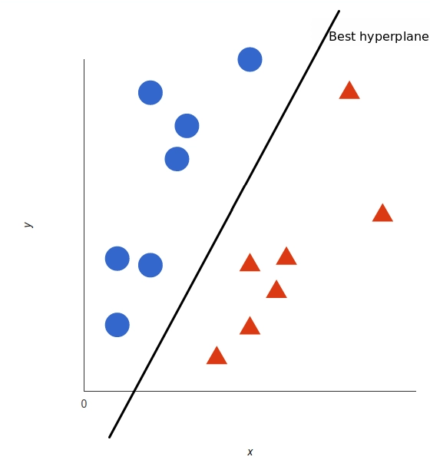


Slide 44
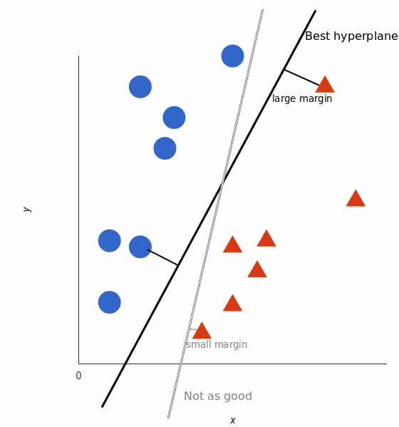
What is the best hyperplane?
For SVM, it’s the one that maximizes the margins from both tags. In other words: the hyperplane (remember it's a line in this case) whose distance to the nearest element of each tag is the largest.

Slide 45
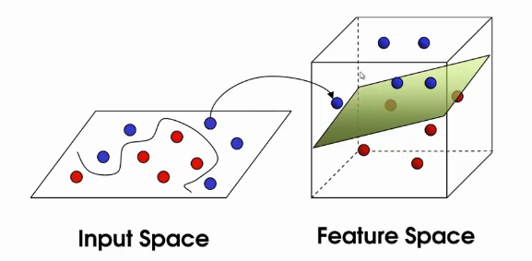
How SVM works in complex data
We have more complex data then SVM will continue to project the data in a higher dimension till it becomes linearly separable. Once the data become linearly separable, we can use SVM to classify just like the previous problems.

Slide 46
What is Kernel
A kernel is a function used in SVM for helping to solve problems. They provide shortcuts to avoid complex calculations. The amazing thing about kernel is that we can go to higher dimensions and perform smooth calculations with the help of it.
Sometimes, we cannot have a hyperplane for certain problems. This problem arises when we go up to higher dimensions and try to form a hyperplane.
A kernel helps to form the hyperplane in the higher dimension without raising the complexity.
Kernels are a way to solve non-linear problems with the help of linear classifiers. This is known as the kernel trick method. The kernel functions are used as parameters in the SVM codes. They help to determine the shape of the hyperplane and decision boundary.
We can set the value of the kernel parameter in the SVM code.

Slide 47
Types of Kernel
Linear
RBF
Polynomial

Slide 48
Re Module in Python
The re module provides a set of powerful regular expression facilities, which allows you to quickly check whether a given string matches a given pattern (using the match function), or contains such a pattern (using the search function). A regular expression is a string pattern written in a compact (and quite cryptic) syntax.

